Slide 1

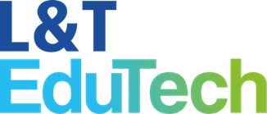
M.Tech Program
Advanced Industry Integrated Programs
Jointly offered by University and LTIMindTree
Real-Time DevOps Incident Triage & Auto-Remediation Agent
Noel Jacob Biju
M.Tech AI&ML with LTiMindtree
VIT Chennai
T9988
Knowledge partner | Implementation partner

Slide 2
Real-Time DevOps Incident Triage & Auto-Remediation Agent
Introduction
Agentic SRE Copilot is an AI-powered multi-agent AIOps platform designed to automate incident management in cloud-native environments. It analyzes logs, metrics, and operational events to perform incident triage, log analysis, metrics analysis, and Root Cause Analysis (RCA). The system uses RAG-based runbook retrieval to provide relevant remediation guidance and leverages Groq LLMs for intelligent decision-making. Built using FastAPI, it offers real-time API access for incident processing. Integration with Kubernetes enables automated recovery actions such as deployment restarts and scaling. By combining AIOps, multi-agent architecture, RCA, RAG, and auto-remediation, the platform reduces incident resolution time, improves operational efficiency, and enhances application reliability and availability.

Slide 3
Real-Time DevOps Incident Triage & Auto-Remediation Agent
Objective
The primary objective of this project is to develop an Agentic SRE Copilot, an AI-powered multi-agent AIOps platform that automates incident management in cloud-native environments. The system aims to perform incident triage, log analysis, metrics analysis, and Root Cause Analysis (RCA) using observability data to rapidly identify and diagnose system failures. It further enhances incident response through RAG-based runbook retrieval and intelligent remediation planning, while leveraging Large Language Models (LLMs) for improved decision-making. Additionally, the project seeks to integrate Kubernetes-based auto-remediation capabilities to reduce Mean Time to Resolution (MTTR), improve operational efficiency, and enhance the reliability, availability, and resilience of modern applications.

Slide 4
Real-Time DevOps Incident Triage & Auto-Remediation Agent
Scope
The Agentic SRE Copilot focuses on automating incident management for cloud-native applications using AI and AIOps techniques. It analyzes logs, metrics, and operational events to perform incident triage, log analysis, metrics analysis, and Root Cause Analysis (RCA). The system employs RAG-based runbook retrieval to provide relevant troubleshooting and remediation guidance. It also supports Kubernetes-based auto-remediation actions such as deployment restarts, pod recovery, and application scaling. By integrating multi-agent architecture, LLMs, and automation, the project aims to reduce downtime, improve incident response efficiency, and enhance the reliability and availability of modern software systems.

Slide 5
Real-Time DevOps Incident Triage & Auto-Remediation Agent
Literature Review
Author(s) | Research Paper | Summary of Paper | Existing Research Limitations
Patrick Lewis et al. (2020) | Retrieval-Augmented Generation for Knowledge-Intensive NLP Tasks | Introduced RAG to improve response quality by combining language models with external knowledge retrieval. | Existing solutions focus on individual capabilities such as RAG, RCA, semantic retrieval, or Kubernetes self-healing.
Nils Reimers & Iryna Gurevych (2019) | Sentence-BERT: Sentence Embeddings using Siamese BERT-Networks | Proposed Sentence-BERT for efficient semantic similarity search using sentence embeddings. | Most systems do not provide end-to-end automation for incident detection, diagnosis, and recovery.
Tianyu Cui et al. (2025) | AetherLog: Log-Based Root Cause Analysis by Integrating LLMs with Knowledge Graphs | Improved root cause analysis accuracy by combining LLMs with knowledge graphs. | Manual intervention is still required for troubleshooting and remediation in many incident management solutions.
Sebastian Schmidl (2019) | Self-Healing Microservices with Kubernetes | Demonstrated Kubernetes-based self-healing and automated recovery in microservice environments. | Limited integration of AI reasoning, knowledge retrieval, and Kubernetes-based auto-remediation within a single platform.

Slide 6
Real-Time DevOps Incident Triage & Auto-Remediation Agent
Summary of Literature
The literature review shows that significant research has been conducted in RAG, semantic embeddings, root cause analysis, and Kubernetes self-healing systems. Existing studies have improved knowledge retrieval, fault diagnosis, and automated recovery individually; however, they lack a unified platform that combines these capabilities. The Agentic SRE Copilot addresses this gap by integrating Multi-Agent AI, RAG, MiniLM embeddings, ChromaDB, LLM intelligence, and Kubernetes auto-remediation to provide end-to-end automated incident management, reduce MTTR, and enable self-healing cloud-native infrastructure.

Slide 7
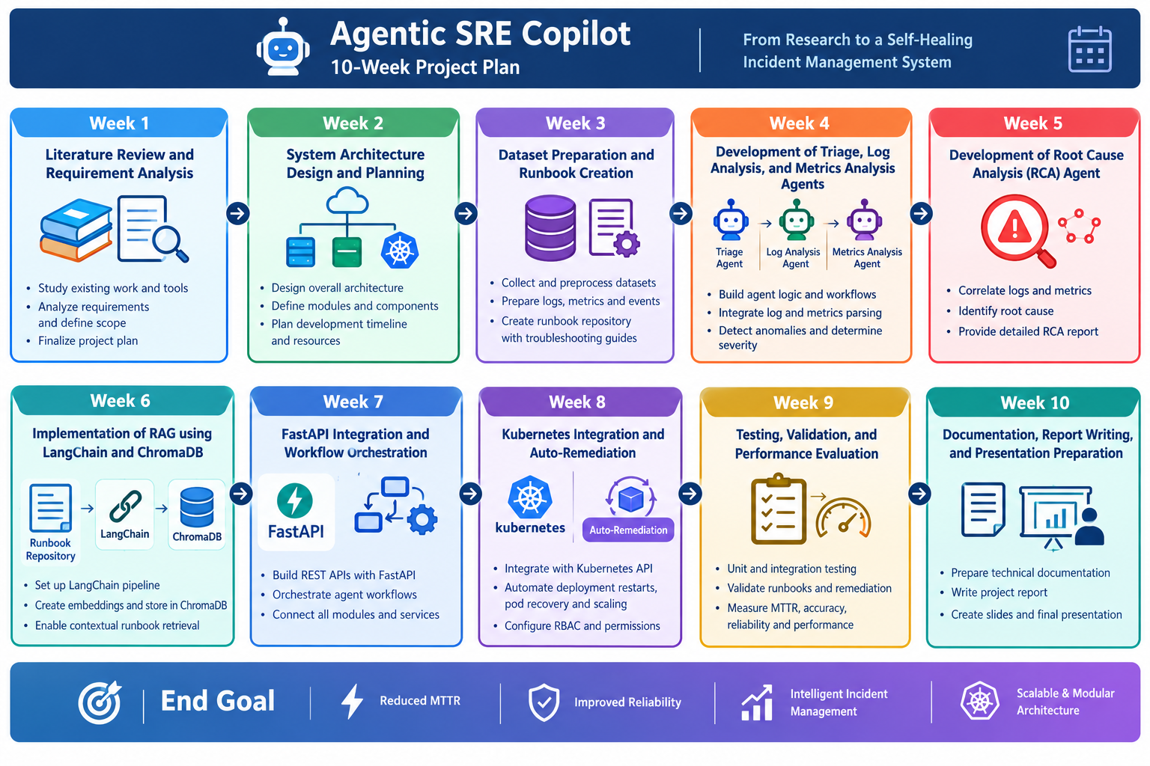
Real-Time DevOps Incident Triage & Auto-Remediation Agent
Timeline

Slide 8
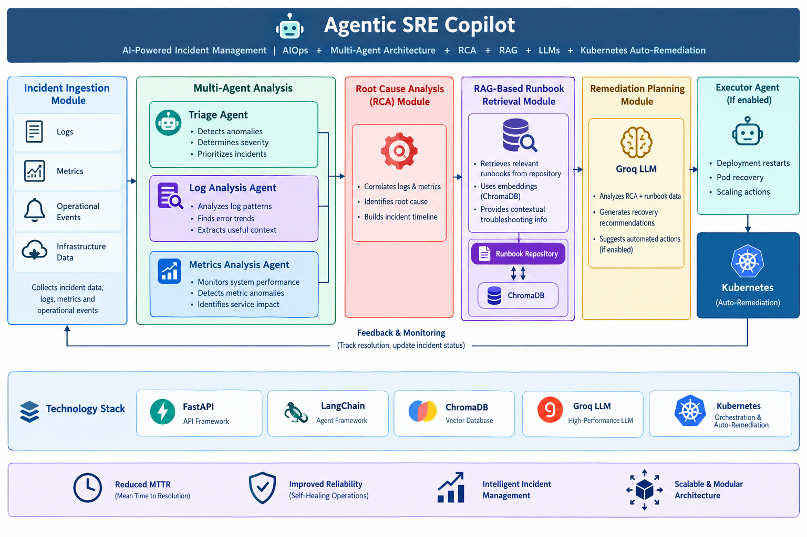
Real-Time DevOps Incident Triage & Auto-Remediation Agent
System Architecture and Workflow Overview

Slide 9
Real-Time DevOps Incident Triage & Auto-Remediation Agent
Technology Stack
Component | Technology | Purpose
Backend & APIs | FastAPI, Swagger UI | API development, testing, and documentation
AI & Orchestration | LangChain, Groq LLM | Intelligent analysis and workflow management
Embeddings & RAG | MiniLM, RAG | Semantic search and context-aware runbook retrieval
Vector Database | ChromaDB | Storage and retrieval of runbook embeddings
Container Orchestration | Kubernetes | Auto-remediation, scaling, and self-healing
Development & Version Control | Python, Git, GitHub | Application development and source code management

Slide 10
Real-Time DevOps Incident Triage & Auto-Remediation Agent
Additional Information
The Agentic SRE Copilot is designed to automate incident management using a multi-agent AI architecture. It analyzes logs, metrics, and operational events to identify and diagnose system issues efficiently. The system performs incident triage, Root Cause Analysis (RCA), and runbook retrieval to support faster resolution of incidents. It leverages Large Language Models (LLMs) and RAG-based knowledge retrieval to provide intelligent remediation recommendations. Integration with Kubernetes enables automated recovery actions such as deployment restarts and scaling. By reducing manual effort and Mean Time to Resolution (MTTR), the solution improves operational efficiency, system reliability, and service availability.

Slide 11
Real-Time DevOps Incident Triage & Auto-Remediation Agent
Modules to cover
The Agentic SRE Copilot is an AI-powered platform that automates incident detection, analysis, and diagnosis in cloud-native environments. It intelligently processes incident data, analyzes logs and metrics, and identifies the most probable root cause of failures. This enables faster incident investigation and reduces manual troubleshooting efforts.
Using RAG-based runbook retrieval and LLM-powered intelligence, the system provides context-aware recovery recommendations for efficient incident resolution. It further enables automated remediation through Kubernetes by performing actions such as deployment restarts and scaling. This end-to-end automation reduces MTTR, improves service reliability, and supports self-healing infrastructure.

Slide 12
Real-Time DevOps Incident Triage & Auto-Remediation Agent
Module name
Module | Description
Incident Ingestion Module | Collects incident data, logs, metrics, and events from monitoring systems and initiates the workflow.
Incident Triage Module | Classifies incidents based on severity and priority to ensure timely response.
Log Analysis Module | Analyzes application and system logs to identify errors, exceptions, and failure patterns.
Metrics Analysis Module | Monitors latency, response time, and resource utilization to detect performance issues.
Root Cause Analysis (RCA) Module | Identifies the underlying cause of incidents by correlating logs and metrics.

Slide 13
Real-Time DevOps Incident Triage & Auto-Remediation Agent
Module name (Continuation)
Module | Description
Runbook Retrieval (RAG) Module | Retrieves relevant troubleshooting guides and remediation runbooks using semantic search.
Remediation Planning Module | Generates recovery recommendations and step-by-step remediation plans.
LLM Intelligence Module | Uses Groq-powered LLMs to provide intelligent reasoning and AI-driven insights.
Kubernetes Auto-Remediation Module | Executes automated recovery actions such as deployment restarts and scaling.
Workflow Orchestration Module | Coordinates all modules and manages the end-to-end incident response workflow.

Slide 14
M.Tech Program
Advanced Industry Integrated Programs
Jointly offered by University and LTIMindTree
Agentic AI-Based Project Health and Risk Monitoring System for Automated Project Governance
Noel Jacob Biju
M.Tech AI&ML with LTiMindtree
VIT Chennai
T9988
Knowledge partner | Implementation partner

Slide 15
Agentic AI-Based Project Health and Risk Monitoring System for Automated Project Governance
Introduction
Organizations today use tools such as Microsoft Planner, Teams, and Excel to manage projects, but project monitoring, risk identification, and status reporting are still largely manual processes. This often results in delayed issue detection, increased management effort, and reactive decision-making. With the growing demand for faster risk identification, better project visibility, and intelligent automation, there is a need for a solution that can proactively monitor project activities and support project managers. To address these challenges, this project proposes an Agentic AI-Based Project Health and Risk Monitoring System. Using Microsoft Copilot Studio, Power Automate, Microsoft Planner or Excel, and Teams, the system automatically monitors project activities, identifies risks and delays, evaluates project health, and generates actionable recommendations. This improves project governance, reduces manual effort, and enables timely and informed decision-making.

Slide 16
Agentic AI-Based Project Health and Risk Monitoring System for Automated Project Governance
Objective
To develop an Agentic AI-based system that automatically monitors project tasks and activities from Microsoft 365 tools.
To identify delayed, blocked, and high-priority tasks for early risk detection.
To evaluate project health and classify projects as Green, Amber, or Red based on predefined criteria.
To generate intelligent recommendations and mitigation actions for identified project risks.
To automate stakeholder communication through Microsoft Teams notifications and email reports, reducing manual project monitoring effort.

Slide 17
Agentic AI-Based Project Health and Risk Monitoring System for Automated Project Governance
Scope
The scope of this project is to develop an Agentic AI-Based Project Health and Risk Monitoring System that automatically monitors project tasks, identifies delays and risks, evaluates project health, and provides actionable recommendations. The system uses Microsoft Planner or an Excel-based Project Tracker as the project data source, Microsoft Copilot Studio for AI-driven analysis, Power Automate for workflow automation, and Microsoft Teams/Outlook for notifications and reporting. It focuses on improving project governance through automated monitoring, risk detection, project health assessment, recommendation generation, and stakeholder communication. The project does not cover financial forecasting, budget management, employee performance evaluation, payroll processing, or customer data analytics.

Slide 18
Agentic AI-Based Project Health and Risk Monitoring System for Automated Project Governance
Literature Review
Author(s) & Paper | Summary of the Paper | Research Gap
Zhiheng Xi et al. (2023) | Explains how LLM-based agents enable autonomous reasoning, decision-making, and task execution. | Does not address project health monitoring or project governance applications.
Guo et al. (2024) | Reviews the architecture and capabilities of autonomous AI agents for complex tasks. | Lacks focus on project risk analysis and automated stakeholder communication.
Adamantiadou & Tsironis (2025) | Highlights the use of AI for project monitoring, forecasting, and decision support. | Does not provide an integrated Agentic AI solution within the Microsoft 365 ecosystem.
Salimimoghadam et al. (2025) | Examines the impact of AI on project efficiency, risk mitigation, and decision-making. | Lacks automated project health assessment and real-time governance mechanisms.
Kristen Kerr (2026) | Discusses how AI enables proactive project risk identification and mitigation. | Does not integrate AI agents with workflow automation, reporting, and notifications.

Slide 19
Agentic AI-Based Project Health and Risk Monitoring System for Automated Project Governance
Summary of Literature
The literature review indicates that Artificial Intelligence, Large Language Models (LLMs), and AI Agents have significantly enhanced automation, decision-making, and risk assessment capabilities across various domains. Existing studies demonstrate the effectiveness of AI in project monitoring, forecasting, and risk management. However, there is limited research on integrating Agentic AI with Microsoft Copilot Studio, Power Automate, Microsoft Planner or Excel, and Microsoft Teams for automated project health monitoring and governance. This gap highlights the need for a unified intelligent system capable of proactive risk detection, recommendation generation, and stakeholder communication, which forms the basis of the proposed project.

Slide 20
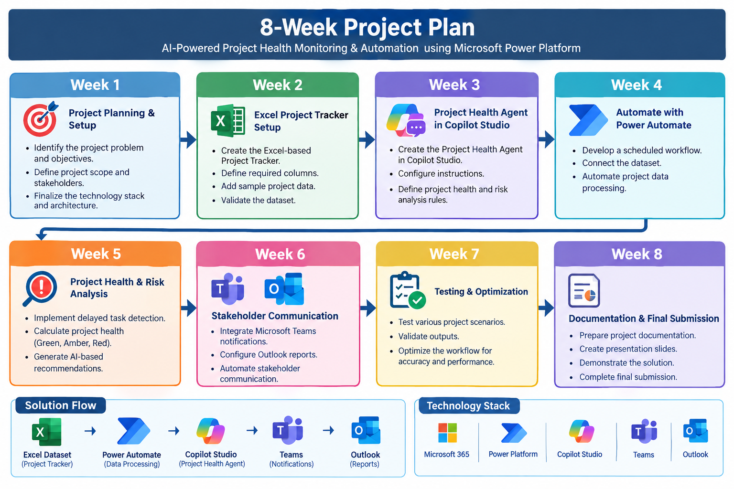
Agentic AI-Based Project Health and Risk Monitoring System for Automated Project Governance
Project Timeline

Slide 21
Agentic AI-Based Project Health and Risk Monitoring System for Automated Project Governance
Technology Stack
Technology | Purpose
Microsoft Planner | Manages project tasks, schedules, priorities, and progress tracking.
Microsoft Copilot Studio | Develops the AI-powered Project Health Agent for risk analysis and recommendation generation.
Power Automate | Automates workflows, integrates services, and orchestrates project monitoring activities.
Microsoft Teams | Delivers project alerts, notifications, and stakeholder communication.
Microsoft Outlook | Sends automated project health reports and escalation emails.
Microsoft Excel (Optional) | Stores project records, reports, and analysis results for reference and tracking.
Microsoft 365 | Provides the integrated cloud environment for collaboration, automation, and AI capabilities.

Slide 22
Agentic AI-Based Project Health and Risk Monitoring System for Automated Project Governance
Additional Information
The project leverages Agentic AI principles, enabling the system to observe, reason, decide, and act autonomously on project data.
The solution is implemented using the Microsoft 365 ecosystem, including Microsoft Planner, Copilot Studio, Power Automate, Teams, and Outlook.
It provides real-time project visibility by continuously monitoring task status, due dates, and priorities.
The system automatically classifies project health as Green, Amber, or Red based on predefined project governance rules.
AI-generated recommendations help project managers take proactive actions before issues become critical.

Slide 23
Agentic AI-Based Project Health and Risk Monitoring System for Automated Project Governance
Modules to cover
Module Name | Description
Project Data Management | Maintains and organizes project task information such as task name, owner, priority, status, and due date for effective monitoring and analysis.
Task Monitoring & Tracking | Continuously monitors project activities and identifies delayed, overdue, or blocked tasks that may affect project progress.
Project Health Assessment | Evaluates the overall project status and categorizes it as Green, Amber, or Red based on predefined health rules.
Risk Detection & Analysis | Identifies potential project risks by analyzing task delays, critical activities, and project dependencies.
AI Recommendation Engine | Utilizes the Copilot Studio Agent to generate intelligent recommendations and mitigation strategies for identified risks.
Automated Reporting | Creates project status summaries and reports automatically, reducing manual reporting effort and improving visibility.
Notification & Stakeholder Communication | Sends project updates, alerts, and recommendations through Microsoft Teams and Outlook to keep stakeholders informed.
Escalation Management | Automatically escalates critical project issues and high-risk situations to project managers and stakeholders for immediate action.

Slide 24
Project Title - Calibri body 18
Module name
Project Data Management Module
Task Monitoring Module
Project Health Assessment Module
Risk Detection and Analysis Module
Agentic AI Recommendation Engine Module
Automated Reporting Module
Teams and Email Notification Module
Escalation Management Module

